Slide 1



Strategies to Improve Feeding Intolerance
Daren K Heyland
Professor of Medicine
Queen’s University, Kingston General Hospital
Kingston, ON Canada

Slide 2

Disclosures
Principal Investigator and Consultant in academic-industry partnered trials sponsored by GlaxoSmithKline, Lyric Pharmaceuticals and E-motion Medical

Slide 3

Q
What do we mean by
‘optimal nutrition?’
A
Patients receiving at least 80% of their prescription
￼

Slide 4
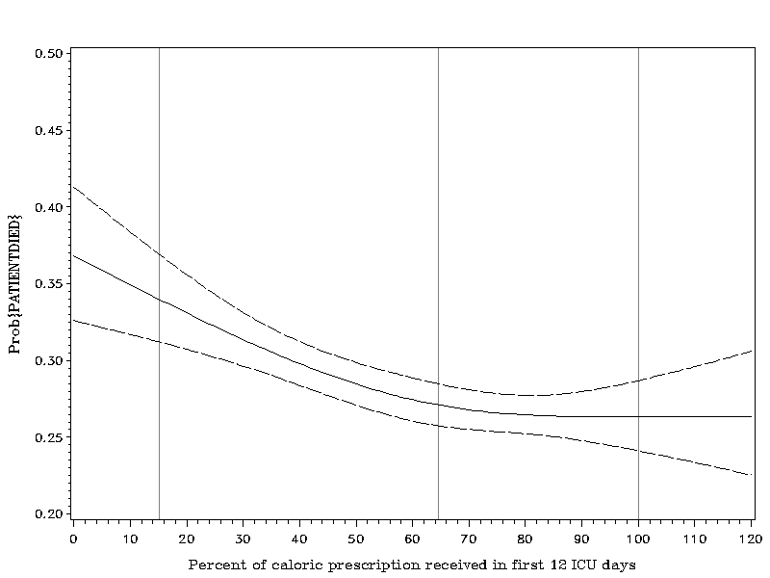
Association Between 12-day Nutritional
Adequacy and 60-Day Hospital Mortality
Optimal amount=
80-85%
Probability of Death
Heyland CCM 2011

Slide 5
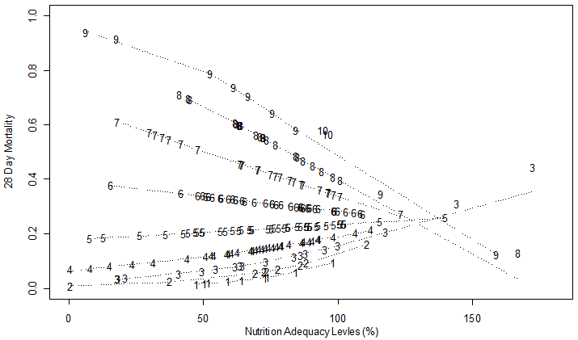
High Nutrition Risk Patients Benefit
from More EN Whereas Low Risk Do Not
Interaction Between NUTRIC Score and Nutritional Adequacy (n = 211)*
Heyland DK, et al. Crit Care. 2011;15(6):R268.

Slide 6
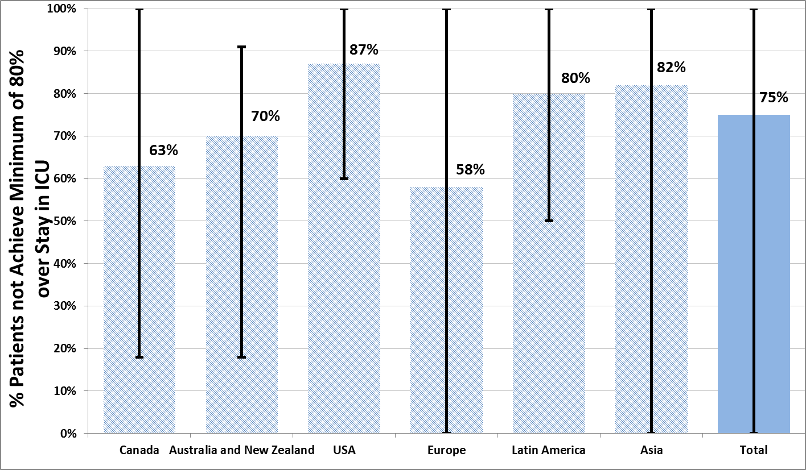
The Prevalence of Iatrogenic Underfeeding
in the Nutritionally ‘At-Risk’ Critically Ill Patient
% high risk patients who failed to meet minimal quality targets (80% overall energy adequacy)
Of all at-risk patients, 14% were ever prescribed volume-based feeds
15% ever received sPN
30% ever prescribed motility agents
Heyland
Clinical Nutrition 2015
7

Slide 7
Reasons for Iatrogenic Underfeeding
Slow starts and slow ramp ups
Interruptions
  Mostly related to procedures
  Not related to GI dysfunction
Can be overcome by better feeding protocols (eg. PEP uP)
Impaired motility/GI Dysfunction
Strategies to improve!

Slide 8
Decreased gastric emptying very common and correlated with GRV

Slide 9
Dysmotility: Contributing factors
Hyper/hypoglycemia
Hypokalemia
Hypophosphotemia
Intra-abdominal hypertension (IAH)
Positive pressure mechanical ventilation
Opioid use
Intravenous catecholamines
Intraoperative intestinal manipulation
Hemorrhage
Fluid overload
Taylor et al, Crit Care Clin 2016

Slide 10
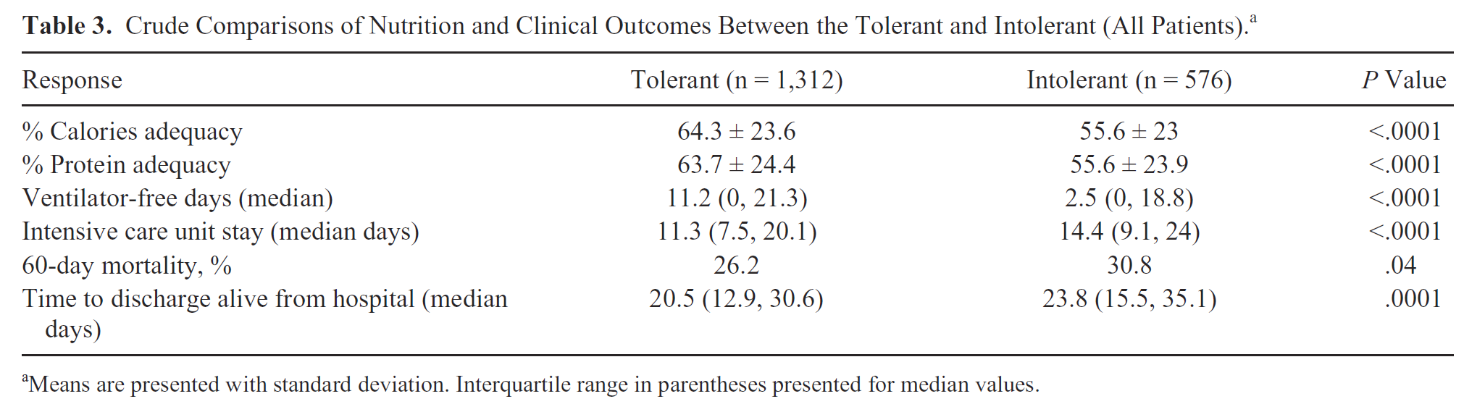
Prevalence, Risk Factors, Clinical Consequences, and Treatment of Enteral Feed Intolerance
During Critical Illness
As defined by local standards (GRV+ interruptions)
Median GRV = 200 mL (range 50-500 mL)
30% Developed intolerance on average on day 3
Gungabissoon 2014 JPEN

Slide 11
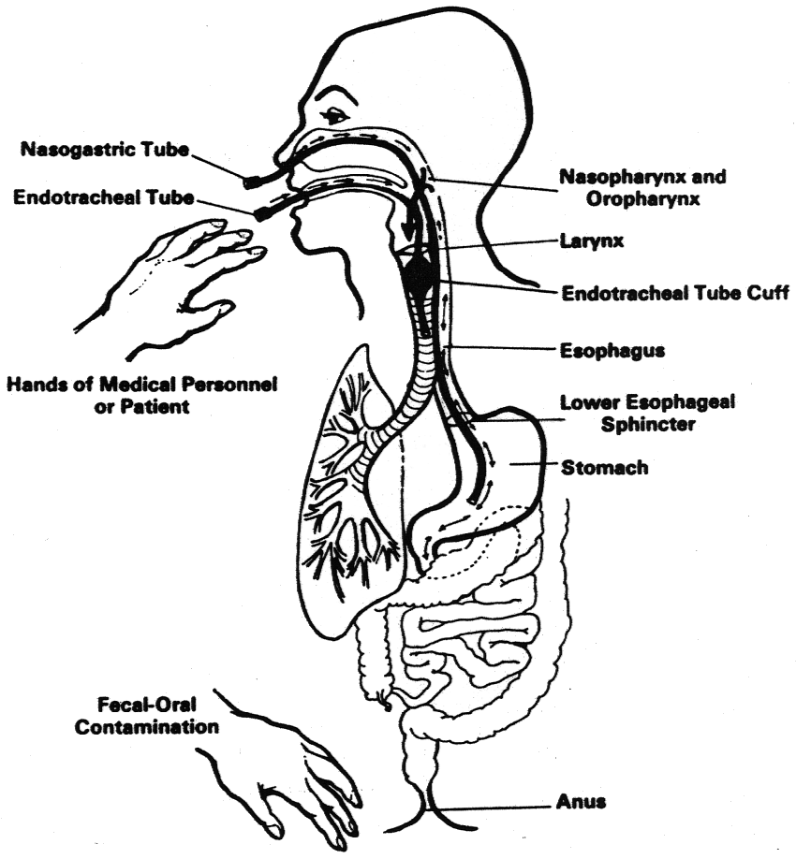
Not just about pushing forward; need to do so safely!
Gastropulmonary Route of Infection

Slide 12
Q
What are the strategies to safely optimize nutrition delivery and minimize risk?
A
Small bowel feeding
GRV assessments
Motility agents
￼

Slide 13
Placing the Feeding tube Postpyloric Reduces Risk of GER and Aspiration
We added radioisotope to the EN and suctioned the back of the throat (GER) and ETT (aspiration)
Tube Position | # of patients | % positive for GER | % positive for Aspiration
Stomach | 21 | 32 | 5.8
D1 | 8 | 27 | 4.1
D2 | 3 | 11 | 1.8
D4 | 1 | 5 | 0
Total | 33 | 75 | 11.7
P=0.004
P=0.09
Heyland CCM 2001;29:1495-1501

Slide 14
Small Bowel vs. Gastric Feeding: A meta-analysis
Other Strategies to Maximize the Benefits and Minimize the Risks of EN

Slide 15
Small Bowel vs. Gastric Feeding: A meta-analysis
Other Strategies to Maximize the Benefits and Minimize the Risks of EN

Slide 16
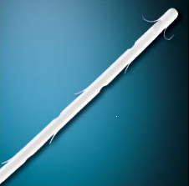
FRICTIONAL ENTERAL FEEDING TUBE
(TIGER TUBETM)
Flaps to allow peristalsis to pull tube passively forward
Sucessful jejunal placement >95%

Slide 17
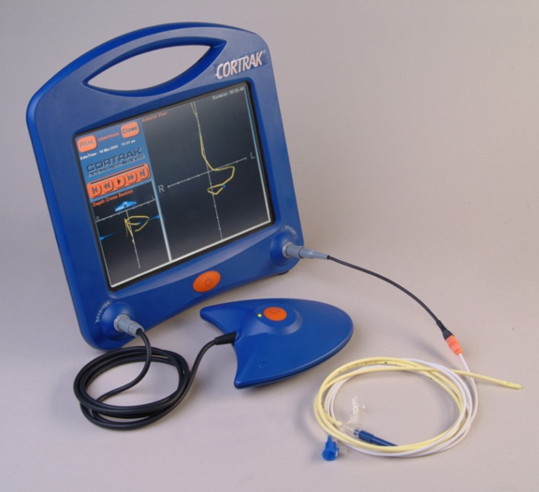
CORTRAK®
A new paradigm in feeding tube placement
  Aid to placement of feeding tubes into the stomach or small bowel
  The tip of the stylet is a transmitter.
  Signal is picked up by an external receiver unit.
  Signal is fed to an attached Monitor unit.
  Provides user with a real-time, graphic display that represents the path of the feeding tube.

Slide 18
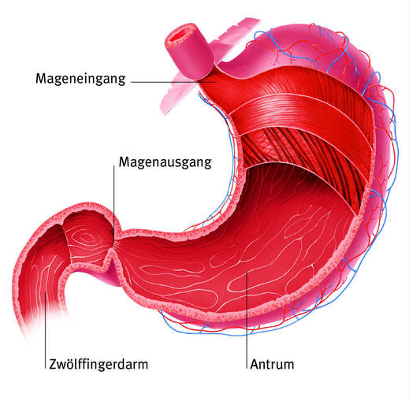


Defining Enteral Feeding Intolerance:
Gastric Residual Volumes
Cardia
GI motility disorders are frequent (up to 80%)
GRV as a surrogate marker to detect GI disorders and avoid risk of aspiration and pneumonia due to regurgitation/vomiting of gastric contents
Lower the GRV, more problems with underfeeding
The higher the GRV, less interruptions
Rate or rapidity of feeding also influences rate of EFI
Pylorus
Duodenum
Antrum
Ukleja A. Nutr Clin Pract. 2010;25:16-25
Lopez-Herce J. Curr Opin Clin Nutr Metab Care. 2009;12:180-5
Notes:
What is the rationale?
The pathophysiology is multifactorial including the severity and etiology of the underlying critical illness, use of narcotic analgesia and other sedatives, decreased blood flow from shock, and use of vasopressors. Gastric dysmotility results in delayed gastric emptying that may place patients at risk of developing complications such as vomiting, aspiration, and ventilator associated pneumonia (VAP).

Slide 19
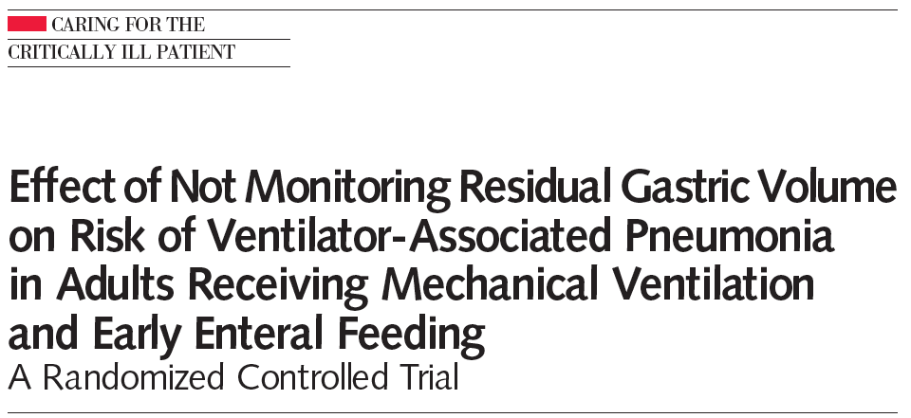
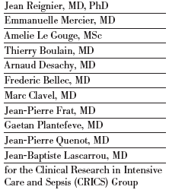
Challenging the role of monitoring GRV
Randomized non-inferiority, open-label, multicenter trial in 9 ICUs in France
449 ICU patients mechanically ventilated >48 hrs and started on EN at goal rate via a nasogastric tube within 36 hrs
Intervention (No GRV monitoring)
  EN intolerance diagnosed by vomiting defined as gastric contents detected in the oropharynx or outside the mouth including spontaneous regurgitation of EN
Control (GRV monitoring)
  EN intolerance diagnosed by vomiting, GRV >250 mL measured every 6hrs by aspiration, or both
Primary outcome
  Proportion of patients with at least 1 VAP episode
Reignier et al. JAMA. 2013;309:249-56

Slide 20
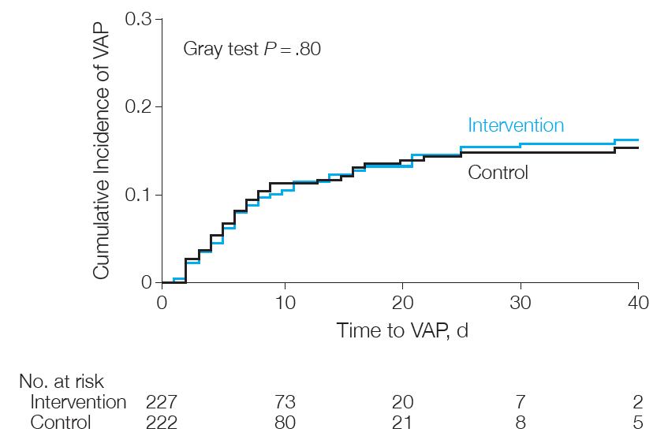
Main Results
No significant differences
other ICU-acquired infections
mechanical ventilation duration
ICU stay length or mortality rates

Slide 21
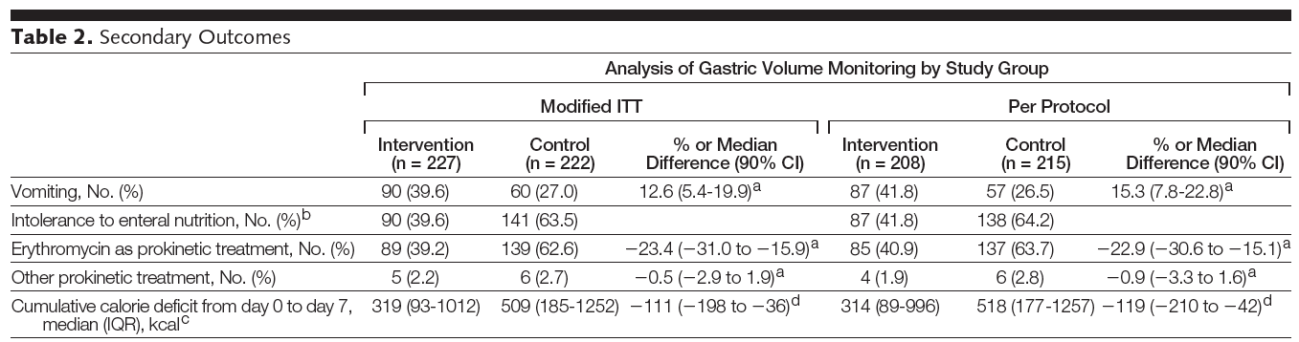
Main Results
No GRV
No GRV
Doesn’t account for
vomiting and loss of EN
Reignier et al. JAMA. 2013;309:249-56

Slide 22
Limitations of the Regenier Trial
Lack of blinding
Limited generalizability
  Aggressive feeding protocol
  >85% medical patients
  ? Patients in shock
  Pre-emptive use of motility agents
When protocolizing care, need to consider the heterogeneity of patients and plan for the most difficult patients. Still check GRV (push threshold higher- to 500)

Slide 23
Systematic Review of Prokinetics in Critically Ill patients receiving EN
Feeding intolerance: GRV > 150 ml, vomiting/abdominal distention leading to interrupted feeding
Prokinetics (erythromycin, metoclopramide)
  Significantly reduced feeding intolerance RR 0.73 p=0.03; 17.3% absolute reduction
  Reduced risk of high gastric residual volumes (RR 0.69, p=0.009)
  Increased success of post-pyloric feeding tube placement (RR 1.6, p=0.004)

Slide 24
Potential Therapeutic Options
Limited Efficacy
+++ side effects
+++Drug-drug interactions
Erythromycin
Metoclopramide
Pipeline Therapeutic Options
Motilin Agonist (GSK)
5HT4 Agonists (Renexion, Takada)
Ghrelin Agonists (Lyric)

Slide 25
Camicinal (GSK962040) – A Novel Motilin Agonist
Scientific Advantages:
  Small, potent, specific motilin agonist
  Long PK and PD action: once daily dosing
  Good bioavailability enterally, good solubility, no food effect
  Eliminated by multiple routes: Should be able to be used in patients with hepatic and renal insufficiencies (TBD)
  No tachyphylaxis to GE effect up to 14 days of administration
  Good safety profile: no significant effect on QT, LFTs to date
GSK962040 has demonstrated safety and effectiveness in it’s ability to enhance gastric emptying in healthy volunteers and patients with diabetic gastroparesis.
? Effect in patients with enteral feeding intolerance.

Slide 26
Nutrition Adequacy Therapeutic Enhancement in the Critically Ill:
A Randomized Double-Blind, Placebo-Controlled Trial of the Motilin Receptor Agonist Camicinal (GSK962040): The NUTRIATE Study
Randomized, placebo-controlled, multicenter trial
Hypothesis: In patients predisposed to feed-intolerance, does pre-emptive camicinal improve the provision of enteral nutrient?
Recruited 84 (of 150) mechanically ventilated patients ‘at risk’ for intolerance:
  Need for vasopressor
  Admission with multi-trauma (ISS > 15)
  Admission with brain injury with (GCS ≤12)
  Received moderate to high opiate (morphine ≥ 2mg/h )
Trial Stopped Prematurely because of lack of treatment effect at Interim Analysis
Deane JPEN 2018

Slide 27
Primary outcome – provision of nutrient
Camicinal: 77% of goal (95% CI 71, 83)
Placebo: 68% of goal (95% CI 58, 78)
Mean difference: 9% (95% CI -5, 23); P=0.21
Incidence of EFI=15% in both groups
Deane JPEN 2018

Slide 29
Naronapride is a Potent and Selective 5-HT4
Receptor Agonist with Dopamine D2 Antagonism
Notes:
it also acts topically on the receptors in the intestinal mucosa and is a substrate for tissue esterases and pGP so that very little of the drug is absorbed unlike cisapride which was cardiotoxic and well absorbed. So the important thing is naronapride learnt from the mistakes of cisapride and was designed to have no cardiotoxic effect and to be non absorbable.
Naronapride also has no effect on the potassium rectifying current (hERG), while cisapride is a potent hERG channel blocker.
Our drug acts on the same receptors as cisapride. However unlike cisapride it has no effect on the heart and is effectively non absorbable and only acts topically on the surface of the mucosa
Good luck
Peter

Slide 30
Beginning RCTs in EFI in ICU patients later this year

Slide 31
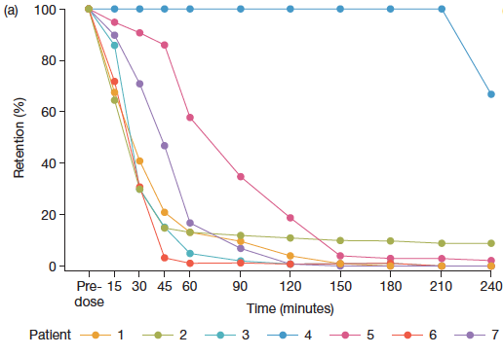
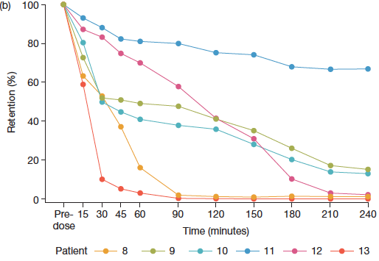
TAK-954: 5HT4 Receptor Agonist
Comparison of effect on gastric emptying of single dose TAK-954 (IV formulation) vs. Metoclopramide in critically ill patients with EFI (GRV>200 mL)
GE assessed by scintigraphy over 4 hours starting within 1 hour post randomized drug dosing
End-point: % gastric retention of label-containing Ensure meal (100 mL) at 180 minutes
TAK-954 produced rapid increase in GE
TAK-954 0.5 mg n=7
Metoclopramide 10 mg n=6
Deane, Chapman, ISICEM 2018

Slide 32
Ghrelin (the Feeding Hormone): More than a pro-motility agent…
Ghrelin
Anti-inflammatory
IL-6, TNF
Prokinetic
Gastric emptying
Protein
Insulin resistance within muscle
GH secretion & IGF-1 production
Muscle breakdown
Anabolic Resistance
32

Slide 33
Rationale for Use of a Ghrelin Agonist in Critically Ill Patients with Enteral Feeding Intolerance
Serum ghrelin is low in critical illness (Basa 2003, Nematy 2006)
  Reduced ghrelin levels have been correlated with enteral feeding intolerance (Crona 2012), ICU-associated muscle wasting (Mesotten 2006, Vanhorebeek 2006), and higher mortality rate (Koch 2010)
Ghrelin agonists restores gastric motility in disease states (Camilleri 2009)
Rapid half-life (minutes) of native ghrelin limits practical use of native ghrelin as a therapeutic agent; ghrelin agonists with longer half-lives are in development
Enteral Formula, Healthy Volunteers
100
90
80
Day 1
n = 51
70
60
% Radiolabeled Meal Remaining
50
40
30
20
10
0
0
0.5
1.0
1.5
2.0
2.5
Time (h)
54% reduction in gastric emptying times
Effects sustained through Day 6
Equates to 15-30% greater reduction than with most other motility agents
James, Digestive Disease Week, Washington, DC 2018
Notes:
Ghrelin agonists are in development as prokinetic agents, as well as anabolic agents for cancer cachexia and sarcopenia in frail, elderly patients.

Slide 34
PROMOTE Trial: Ulimorelin in Enteral Feeding Intolerance
Phase 2, Multicenter, Randomized, Double-Blind, Comparator-Controlled Study of the Efficacy, Safety, and Pharmacokinetics of Intravenous Ulimorelin (LP101) in Patients with Enteral Feeding Intolerance (EFI)
Sponsor: Lyric Pharmaceuticals
Design: 120 patients, randomized 1:1 to ulimorelin 600 µg/kg or metoclopramide 10 mg by 30 minute IV infusion Q8H for 5 days
25 investigative sites in US, Canada, Spain and Netherlands
Key inclusion criterion: gastric residual volume ≥ 500 mL at screening
Primary endpoint: Protein received through enteral nutrition as a percentage of the daily protein prescription
Secondary endpoint: Calories received through enteral nutrition as a percentage of the daily calorie prescription
Finish Enrollment-
Results presented at ESPEN 2018

Slide 35
Summary of Key Findings
Ulimorelin was no more efficacious than metoclopramide in promoting protein intake, with the majority of patients achieving feeding success regardless of treatment
The incidences of vomiting and regurgitation were low or and EFI episodes (GRV ≥ 500 mL) declined rapidly upon treatment. Patients could be fed to goal if feeding persisted, even when EFI recurred
The risk factors for reduced protein intake were 2 or more episodes of GRV ≥ 500 mL and use of sedatives at baseline
No association was found between the incidence of a GRV ≥ 500 mL, positive tracheal aspirate for pepsin, and probability of ICU-acquired pneumonia
The safety profile of metoclopramide and ulimorelin were similar
  In particular, the incidences of adverse events due to agitation, delirium and QT prolongation were no different between ulimorelin and metoclopramide patients

Slide 36
Key Inferences from Lyric Trial
Patients with EFI can tolerate a volume-based feeding protocol and achieve feeding goals when a prokinetic agent like ulimorelin or metoclopramide is administered
The study did not include a placebo and did not address the possibility that EFI patients improved spontaneously (without the use of a prokinetic agent)
  If EFI patients did recover spontaneously, they should be considered tolerant unless at least 2 episodes of GRV ≥ 500 mL are recorded in proximity
The value of GRV ≥ 500 mL in predicting aspiration and ICU-acquired pneumonia is uncertain
The toxicity of metoclopramide cannot be confirmed in the setting of a double-blind, randomized trial
  The reported toxicity of metoclopramide could be the result of injection (2-3 min), and its safety profile could be enhanced by administering it as a 30 min infusion

Slide 37
Q
Take home message?
Burden of illness associated with EFI is high
Abnormal GI motility central to underlying mechanism
Bypassing the stomach with small bowel feeding remains a good therapeutic option
Measuring GRVs remains controversial but I still recommend it at 500 ml
Restoring motility through novel drugs may hold some promise- stay tuned!
A

Slide 38
Questions?
?

